Slide 1
Coronavirus Safety Training For Medium and High Risk Employees
INSERT LOGO
COMPANY NAME
AND DATE OF TRAINING
Photo Credit: Centers for Disease Control

Slide 2
Agenda
We’ll discuss:
How is the Coronavirus spread?
The importance of hygiene habits
What is my risk of exposure here at work?
Employee Risk Exposure Assessment – Results
What is our company doing from a sanitization perspective?
Review of our company’s COVID-19 Company Response Plan
What should I do if I develop symptoms while at work?
What should I do if I develop symptoms while at home?
8. Questions + Answers

Slide 3
HOW DOES THE CORONAVIRUS SPREAD?
Photo Credit: Centers for Disease Control

Slide 4
“How does Coronavirus actually spread?”
The primary mode of transmission is from droplets of mucus that are aerosolized when a person coughs/sneezes.
The airborne particles enter the eyes/nose/mouth of a person close to them.
This is why it is so important for you to cover your mouth when you cough, and sneeze into your elbow. Then wash your hands immediately after.
The secondary mode of transmission is when the cough/sneeze droplets land on surfaces, then, a person touches those surfaces with his/her hands and then touches his/her mouth, nose, or eyes.
Our custodians have implemented a Sanitation Plan to clean surfaces, but it is critical that you are mindful of not touching your face.

Slide 5
Photo Credit: Centers for Disease Control
WHAT IS MY RISK
OF EXPOSURE
HERE AT WORK?

Slide 6
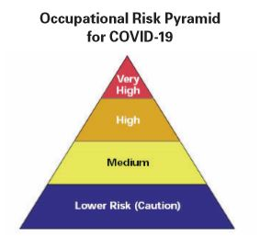
EMPLOYEE RISK EXPOSURE ASSESSMENT
Photo Credit: Hilgeman Group

Slide 7
THE EMPLOYEE RISK EXPOSURE ASSESSMENT DETERMINES WHICH CATEGORIES EMPLOYEES FALL INTO:
VERY HIGH
HIGH
MEDIUM
LOW
Photo Credit: Hilgeman Group

Slide 8
EXPOSURE LEVEL: VERY HIGH RISK
Employees who are considered by OSHA and the CDC to have a ‘very high risk exposure’ to COVID-19 includes those people who:
Are medical professionals who perform aerosol-generating medical procedures, such as intubation, bronchoscopies, cough inducing procedures, etc.
Most FOUNDRIES will NOT have any VERY HIGH RISK employees in their organizations.

Slide 9
EXPOSURE LEVEL: HIGH RISK
Employees who are considered by OSHA and the CDC to have a ‘high risk exposure’ to COVID-19 includes those people who:
Provide basic medical response (non-aerosol generating tasks) in the workplace.
Provide the transportation of a sick employee to the hospital or clinic.
Most employers will have the following HIGH RISK employees in their organizations:
Company nurses
First Responders
First Aid providers

Slide 10
EXPOSURE LEVEL: MEDIUM RISK
Employees who are considered by OSHA and the CDC to have a ‘medium risk exposure’ to COVID-19 includes those people who:
have anticipated and frequent exposure to the public, publicly handled goods, and potentially contaminated surfaces, as part of their routine job duties.
Most employers will have the following MEDIUM RISK employees in their organizations:
Custodial staff
Receptionists
Mailroom personnel
Delivery drivers
Human Resources (in some cases)

Slide 11
EXPOSURE LEVEL: LOW RISK
Employees who are considered by OSHA and the CDC to have a ‘low risk exposure’ to COVID-19 includes those people who:
Do not have anticipated and frequent exposure to the public, publicly handled goods, and potentially contaminated surfaces, as part of their routine job duties.
Most employers will have the following LOW RISK employees in their organizations:
All employees who are not otherwise classified at Very High, High, or Medium.
THIS TRAINING SESSION IS FOR THOSE IN MED TO HIGH RISK GROUPS.

Slide 12
TYPICAL PPE DETERMINATIONS PER RISK CATEGORY
VERY HIGH | HIGH | MEDIUM | LOW
Most workers at a very high exposure risk will need to wear:
Latex Gloves
Gown
Face shield or goggles
Respirator
Other items depending on their job tasks and specific exposure risks.
Most workers at a high exposure risk will need to wear:
Latex Gloves
Face shield or goggles
Respirator
Other items depending on their job tasks and specific exposure risks.
Most workers at a medium exposure risk will need to wear:
Latex Gloves
Face shield or safety glasses
Respirators required in some cases – but needs to be determined on a case-by-case basis.
Most workers at a low exposure risk will need to wear:
No PPE

Slide 13
PPE REQUIREMENTS
Each of you will have specific PPE requirements based on the selected tasks that you perform here at work.
The PPE will be ordered by: ENTER NAME
The PPE will be stored in the: ENTER LOCATION
If you have any specific questions/concerns about the PPE and what might or might not be suitable for a task you intend to perform, contact your Supervisor or the Safety Manager prior to performing that tasks.

Slide 14
WHAT IS OUR COMPANY DOING WITH REGARDS TO SANITIZATION?

Slide 15
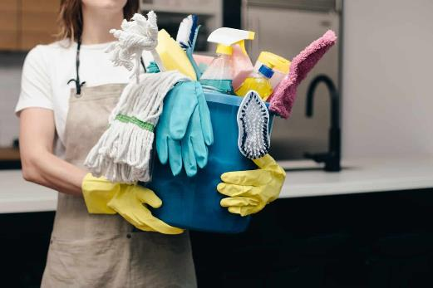
SANITIZATION PLAN
Photo Credit: Branch Environmental

Slide 16
Our Company Has Implemented an Emergency Sanitization Plan
Our cleaning staff has been trained on and has implemented a facility-wide sanitization plan.
This includes the wiping down of all direct contact surfaces with hospital-grade disinfectants.

Slide 17
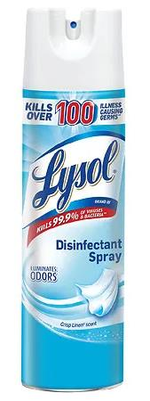
Let’s look at break rooms and
lunchrooms for example:
Break rooms and lunchrooms are being sanitized with a hospital-grade disinfectant (Lysol, bleach/water, etc.) on the following surfaces:
Door handles and pushes
Light switches
Furniture including knobs and pulls
All horizontal surfaces
Chairs and arm rests
Appliances, Microwaves, Etc.
Trash can lids
Vending machine surfaces
Drinking fountains and water coolers

Slide 18
Sanitization Plan
A word about bleach solutions for sanitation
1/3 cup household bleach per gallon of water
3 teaspoons bleach per quart of water
WARNING: DO NOT MIX BLEACH WITH ANY OF THESE CLEANERS:
Vinegar + bleach = chlorine gas
Ammonia + bleach = chloramine
Rubbing alcohol + Bleach = chloroform
Bottom line – don’t mix bleach with anything except water

Slide 19
Coronavirus on Surfaces
The latest testing has revealed that the coronavirus remains virulent for:
4 hours on copper
24 hours on cardboard
24-36 hours on paper
2-3 days on plastic
2-3 days on stainless steel
This is why it is important for our cleaning staff to be diligent with regards to surface disinfecting.

Slide 20
WHAT POLICIES HAS OUR COMPANY IMPLEMENTED TO ADDRESS COVID-19?

Slide 21
OUR COMPANY HAS DEVELOPED AND IMPLEMENTED A
COVID-19
RESPONSE PLAN

Slide 22
Our response plan includes:
Communication
Response to employees with symptoms
Response to employees calling in sick
Response to confirmed positive COVID-19 cases
Travel and meeting restrictions
Visitor restrictions
Sanitizing plans

Slide 23
What can you do?
Wash your hands or use hand sanitizer
Stay 6’ apart (social distancing)
Cover your cough
If you’re sick with flu-like symptoms DO NOT come to work!
Fever
Cough
Body Aches
If you think (or know) you have been exposed:
Call-in for instruction.

Slide 24
Be sure to sign the training sheet
before you leave.
THANK YOU!

