Slide 1
AMERICAN FOUNDRY SOCIETY – OSHA UPDATE
June 11, 2019

Slide 2
Enforcement Data For 2019
Key Enforcement Programs
Significant Legal Decisions in 2018
What’s in Store for Employers in 2019
Drugs in the Workplace ….

Slide 3
OSHA’s Top 10 Most Frequently Cited Standards
Fall Protection – General Requirements (1926.501)
Hazard Communication (1910.1200)
Scaffolding (1926.451)
Respiratory Protection (1910.134)
Lockout / Tagout (1910.147)
Ladders (1926.1053)
Powered Industrial Trucks (1910.178)
Fall Protection – Training Requirements (1926.503)
Machine Guarding (1910.212)
Eye and Face Protection (1926.102)

Slide 4
Total Fed OSHA Inspections

Slide 5
Average Penalty Per Serious Violation

Slide 6
Severe Injury Reporting
Type of Injury Reported | # of Reports (2015) | % Inspected (2015) | # of Reports (2016) | % Inspected (2016) | # of Reports (2017) | % Inspected (2017) | # of Reports (2018) | % Inspected (2018)
HOSPITALIZATION | 7,638 | 31% | 8,100 | 27% | 8,063 | 25% | 9,135 | 27% (73% RRI)
AMPUTATION | 2,646 | 59% | 2,672 | 49% | 3,379 | 47% | 2,922 | 48% (52% RRI)
TOTAL | 10,395 | 38% (3,950) | 10,887 | 33% (3,593) | 11,592 | 30% (3,478) | 12,238 | 32% (3,918)

Slide 7
E-Recordkeeping Data

Slide 8
Site Specific Targeting
On Oct. 16, 2018, OSHA published Site-Specific Targeting 2016 (SST-16) inspection plan
Outlines OSHA’s strategy for targeting establishments for inspection based on CY2016 300A injury data collected under the Agency’s new E-Recordkeeping Regulation
Inspections are comprehensive
Coordinated with NEPs (i.e., if an establishment is covered by NEP and is selected for an SST-16 inspection, the SST and NEP inspections will run concurrently)

Slide 9
Top Ten Silica Violations
Top Ten General Industry Silica Standards Issued DATES: 6/23/2018 to 2/7/2019
STANDARD | TOTAL VIOLATIONS ISSUED | INITIAL PENALTY AMOUNT* | CURRENT PENANTY AMOUNT*
1910.1053(d)(1) | 9 | $32,369 | $27,858.2
1910.1053(f)(1) | 5 | $4,268 | $4,268
1910.1053(j)(1) | 5 | $15,281 | $5,812
1910.1053(c) | 4 | $29,765 | $25,016.1
1910.1053(j)(3)(i) | 4 | $0 | $0
1910.1053(e)(1) | 3 | $7,760 | $6,180
1910.1053(f)(2)(i) | 3 | $3,978 | $3,978
1910.1053(j)(2) | 3 | $0 | $0
1910.1053(d)(3)(i) | 2 | $0 | $0
1910.1053(d)(3)(iv) | 2 | $6,467 | $4,526.9
*penalty amounts account for cumulative total violations issued

Slide 10
Silica Inspection Data
GENERAL INDUSTRY INPECTIONS CODED: N-02-SILICA | 6/23/2018 to 2/7/2019
Total Inspections Conducted # Safety Inspections # Health Inspections % Programmed % Unprogrammed % General Industry %Other % Follow-up | 71 4 67 22% 78% 73% 27% 1.4%
Inspections With Violations* (In-Compliance Rate) | 34 (29%)
Total Violations Cited % Issued As Serious % Issued As S,W,R,U | 267 64% 69%
Avg. Violations Cited Per Initial Violation | 3.3
Avg. Current Penalty Per Serious Violation | $4,370

Slide 11
Mar-Jac: Limiting OSHA Inspection Scope
U.S. v. Mar-Jac Poultry – 11th Circuit (October 2018)
Unprogrammed injury inspection- OSHA requested 3 yrs of 300 Logs
Based on injuries on the Logs, OSHA got a warrant to inspect the facility for other hazards associated w/ the recorded injuries
11th Cir. quashed the warrant, explaining:
Information on 300 Log does not establish reasonable suspicion b/c the existence of an injury does not establish a violation of an OSHA standard
7 slip, trip and fall injuries is insufficient evidence of administrative probable cause for a facility w/ 1000+ employees

Slide 12
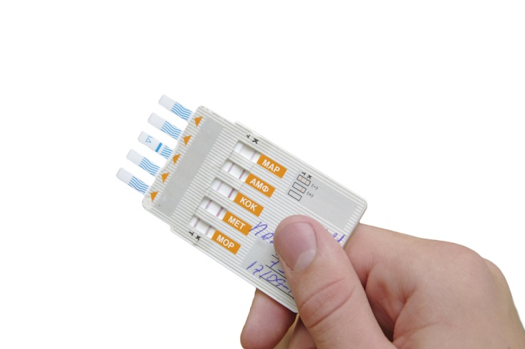
New OSHA Guidance on Safety Incentive Programs and Post-Accident Drug Testing
Safety Incentive Programs
One type of incentive program rewards workers for reporting near-misses or hazards, and encourages involvement in a safety and health management system. Positive action taken under this type of program is always permissible.
Another type of incentive program is rate-based and focuses on reducing the number of reported injuries and illnesses. This type of program typically rewards employees with a prize or bonus at the end of an injury-free month or evaluates managers based on their work unit's lack of injuries. Rate-based incentive programs are also permissible as long as they are not implemented in a manner that discourages reporting. Thus, if an employer takes a negative action against an employee under a rate-based incentive program, such as withholding a prize or bonus because of a reported injury, OSHA would not cite the employer as long as the employer has implemented adequate precautions to ensure that employees feel free to report an injury or illness.
A statement that employees are encouraged to report and will not face retaliation for reporting may not, by itself, be adequate to ensure that employees actually feel free to report, particularly when the consequence for reporting will be a lost opportunity to receive a substantial reward. An employer could avoid any inadvertent deterrent effects of a rate-based incentive program by taking positive steps to create a workplace culture that emphasizes safety, not just rates. For example, any inadvertent deterrent effect of a rate-based incentive program on employee reporting would likely be counterbalanced if the employer also implements elements such as:
an incentive program that rewards employees for identifying unsafe conditions in the workplace;
a training program for all employees to reinforce reporting rights and responsibilities and emphasizes the employer's non-retaliation policy; and
a mechanism for accurately evaluating employees' willingness to report injuries and illnesses.

Slide 13
New OSHA Guidance on Safety Incentive Programs and Post-Accident Drug Testing (cont’d)
Post Accident Drug Testing – What is Acceptable?
Random drug testing.
Drug testing unrelated to the reporting of a work-related injury or illness.
Drug testing under a state workers' compensation law.
Drug testing under other federal law, such as a U.S. Department of Transportation rule.
Drug testing to evaluate the root cause of a workplace incident that harmed or could have harmed employees. If the employer chooses to use drug testing to investigate the incident, the employer should test all employees whose conduct could have contributed to the incident, not just employees who reported injuries.
To the extent any other OSHA interpretive documents could be construed as inconsistent with the interpretive position articulated here, this memorandum supersedes them….

Slide 14
Electronic Reporting
OSHA has withdrawn requirement that employers submit OSHA 300 Logs and 301 Forms
300A Form submission remains
OSHA has not publicly disclosed information
Agency has denied FOIA requests for the information
Section 11(c) retaliation tool remains and OSHA is using it!
Nat’l Assn of Home Builders, (W.D. Okla. Jan. 2017) – data submission litigation has been restarted

Slide 15
Regulatory Agenda
Request for Information on Powered Industrial Trucks
Request for Information on Lockout/Tagout
Request for Information on “Table 1”
Proposal to amend recordkeeping rules again to add current positions on safety incentive programs and post-accident drug testing programs in regulatory text

Slide 16
Substance Abuse & Work
Drug use in the United States at a 12-year high, according to Quest Diagnostics
Methamphetamine abuse
Opioid abuse
Marijuana & marijuana products
Over 28 million Americans admitted using illegal drugs in past month; during the same period, 16 million admitted “heavy” alcohol use – National Survey on Drug Use and Health, SAMHSA (September 2017)

Slide 17
Quest Diagnostics Drug Testing Index

Slide 18
Addiction Enters the Workplace
Labor pool shortage
Prescription abuse detection hard, strikes successful employees
Attendance issues (employees/family members)
Increased errors, including safety errors
How the Prescription Drug Crisis Is Impacting American Employers (2017)

Slide 19
Federal Law & Marijuana
Americans with Disabilities Act and Illegal Drugs:
Individuals engaging in the current illegal use of drugs are not considered disabled for that reason; it is not discrimination to take adverse action on the basis of illegal drug use
“Illegal use of drugs” means use that is unlawful under the Controlled Substances Act, but excludes from this definition the use of drugs taken under supervision of a health care professional
There are lawfully prescribed medications that contain THC
To date, courts in agreement that employers may take adverse action on the basis of marijuana use, regardless of whether such use is pursuant to physician guidance or state medical marijuana program
Note: if individual who abuses illegal drugs is not terminated, obligation to accommodate underlying disability continues –

Slide 20
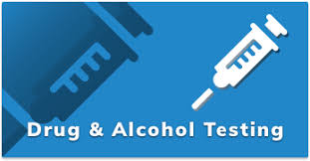
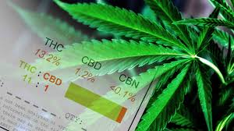
Federal Law & Marijuana
U.S. Department of Transportation Regulations
Cover 8 million+ private sector workers in transportation work
Prohibit drug abuse and alcohol misuse
Require drug & alcohol testing
Marijuana use of any kind prohibited for regulated workers. Yes, this includes CBD products

Slide 21
State Recreational Marijuana Laws
WA
MT
ND
MN
WI
ME
OR
SD
MI
VT
ID
WY
NY
NH
IA
MA
NE
*
CT
CA
IL
OH
PA
RI
NV
IN
MD
NJ
UT
CO
KS
DE
New York City
MO
KY
WV
VA
AZ
OK
TN
NC
Washington, D.C.
NM
AR
MS
AL
GA
SC
TX
LA
Alaska
FL
Hawaii
Puerto Rico

Slide 22
States That Do NOT Allow Use of Medical Marijuana
W
A
MT
ND
MN
ME
SD
WI
VT
OR
ID
MI
W
Y
NY
NH
IA
MA
RI
NE
IN
P
A
CT
NV
IL
OH
NJ
CA
UT
C
MD
O
K
S
MO
W
V
DE
K
Y
V
A
AZ
OK
TN
NC
NM
AR
MS
SC
TX
LA
AL
GA
FL
A
L
A
S
K
A
H
A
W
A
I
I
PUE
R
T
O RI
C
O

Slide 23
No Protections for Medical Marijuana Users at Work
California
Colorado
Michigan
Montana
Oregon
Washington
Reviewing courts in these states (or federal courts evaluating state law) have decided that the laws in these states do not provide employment law protection.
In each case, federal / state law conflict controlled the outcome…until
Massachusetts goes the other way
NORML-led efforts to revisit or change law underway at the legislative level

Slide 24
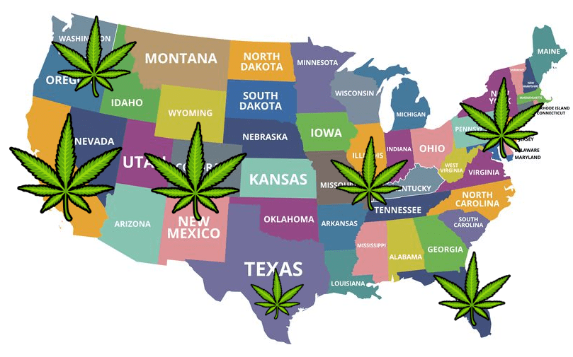
Statutory Protections for Workers Using Medical Marijuana
New Mexico
New York
Oklahoma
Pennsylvania
Rhode Island
West Virginia (2019)
Arkansas
Arizona
Connecticut
Delaware
Illinois
Maine
Minnesota
Nevada

